Slide 1

Hotel Booking Cancellation Analysis
An Exploratory Data Analysis
By Aya Ginidy

Slide 2
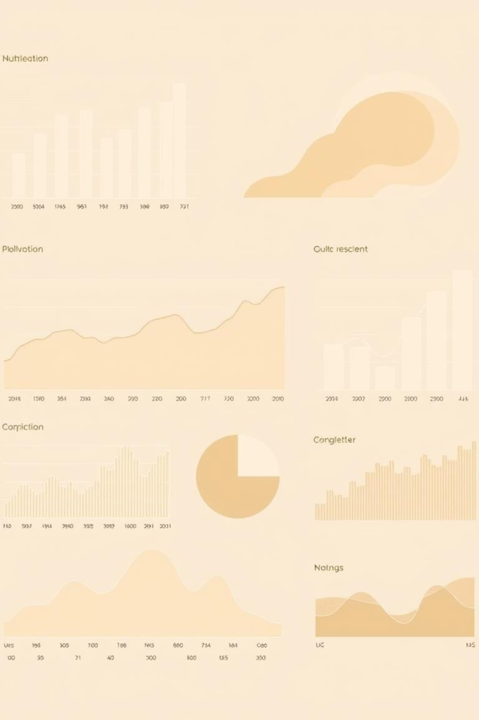
Introduction & Methodology
Our objective is to understand key factors influencing hotel booking cancellations by visually analyzing data distribution and its relationship with booking status.
We will ask a specific question for each of the 17 columns in the dataset. A Python script will generate visualizations (histograms, boxplots, count plots) to answer these questions and uncover initial insights.

Slide 3
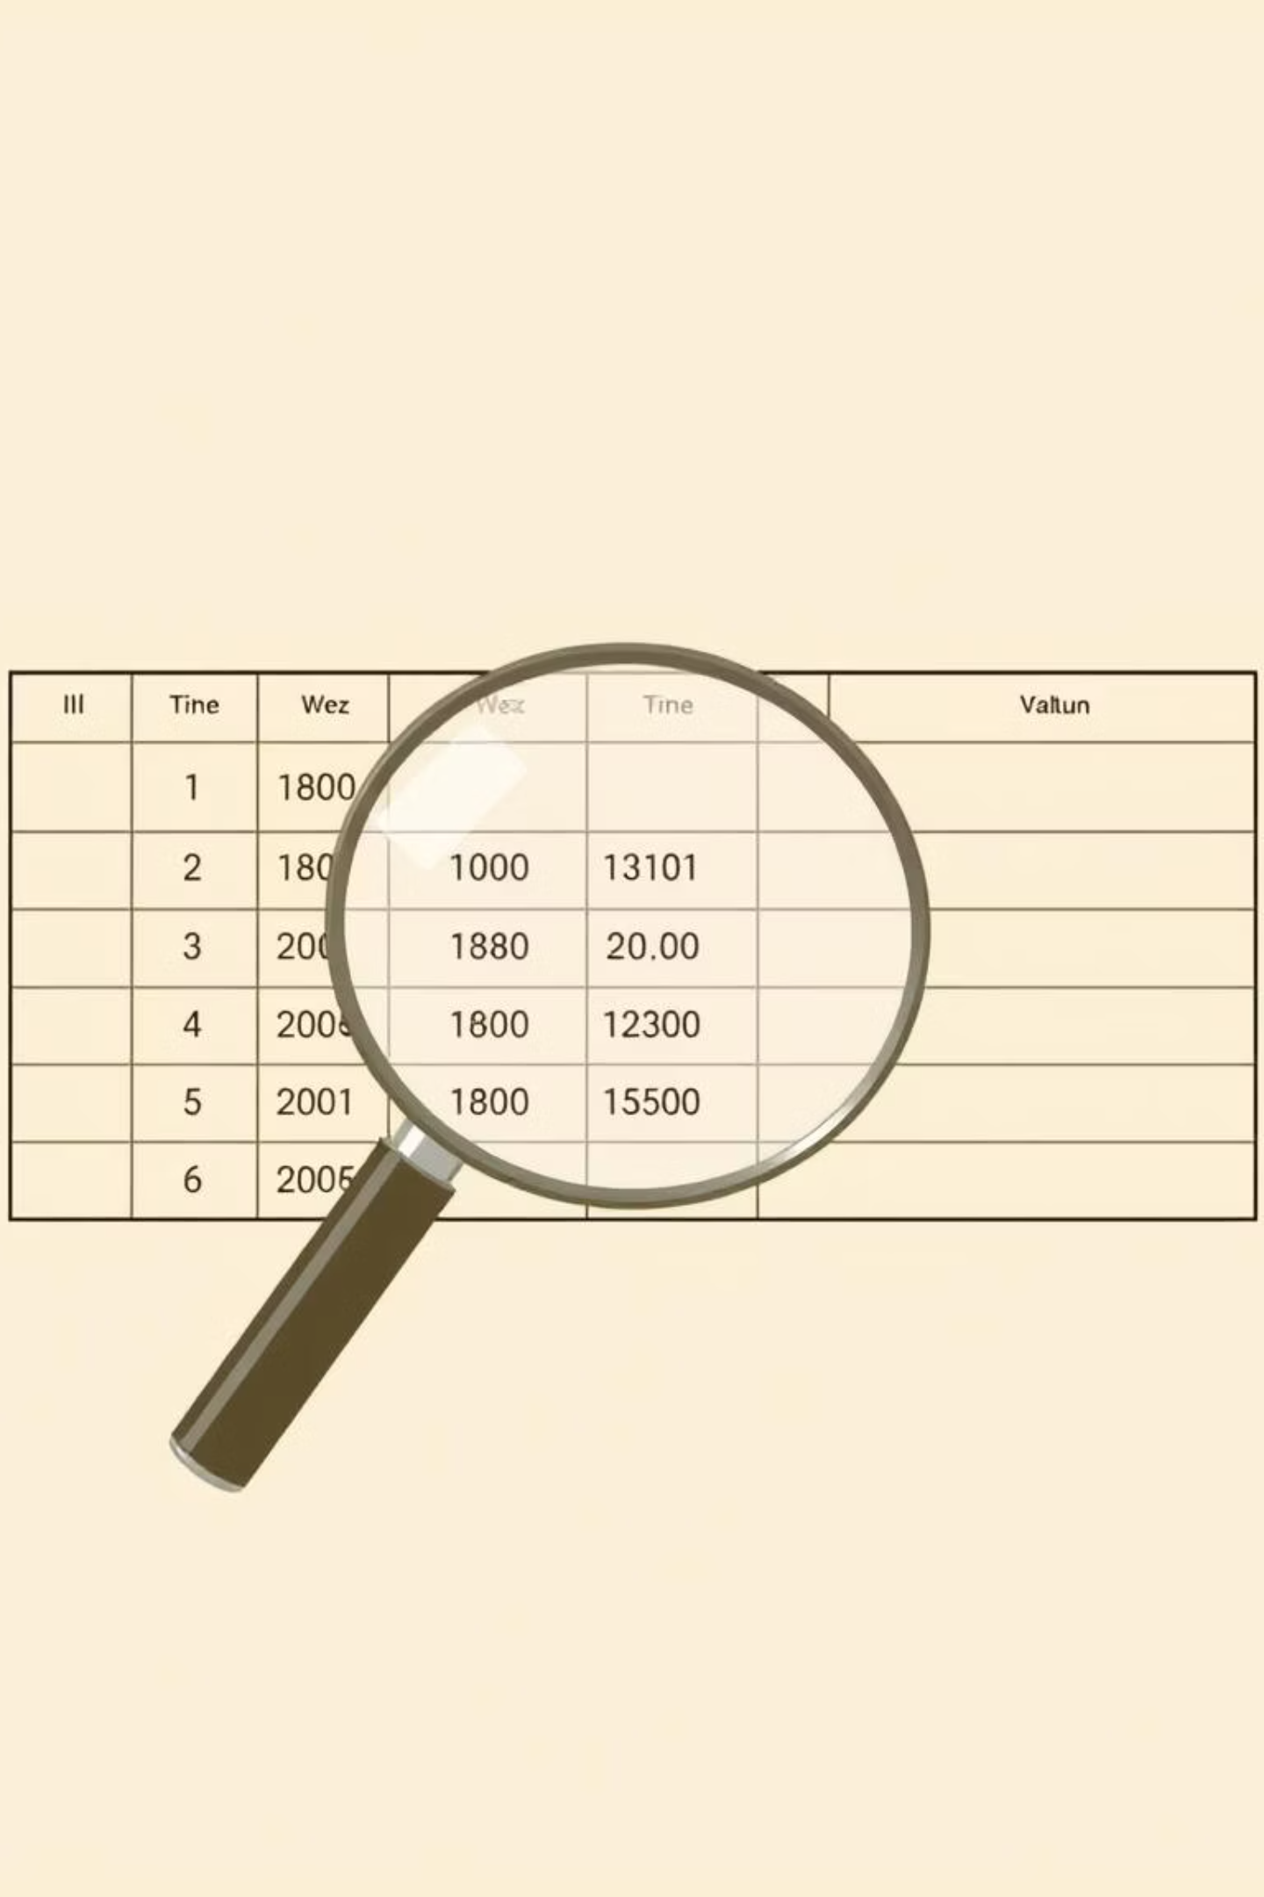
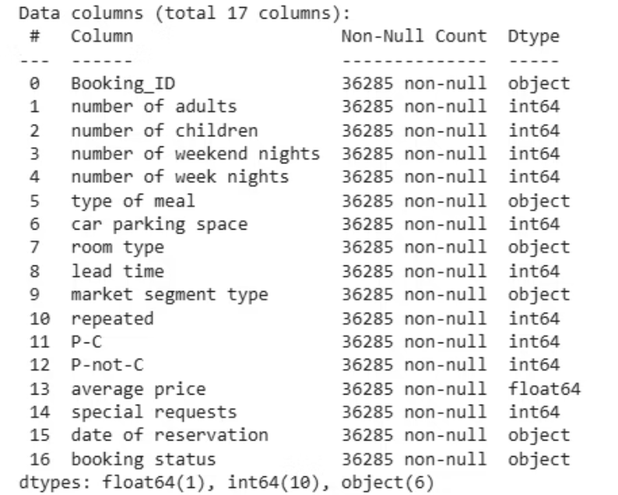
Understand the Dataset
Size
Data Information
Row : 36285Columns : 17

Slide 4

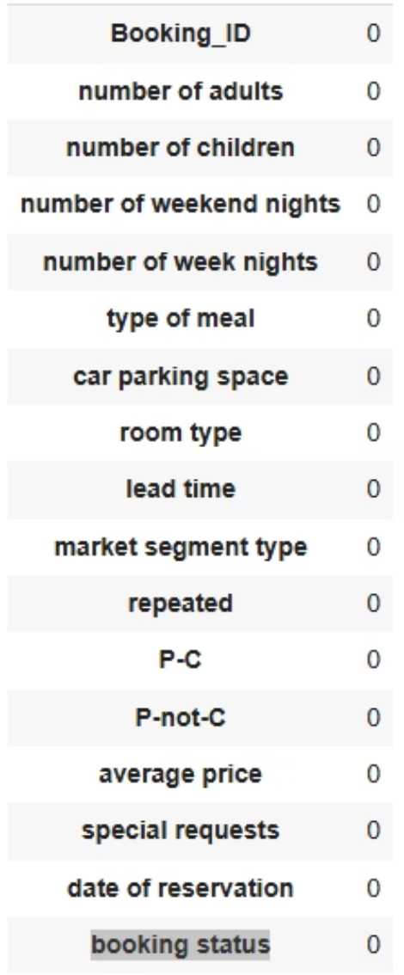
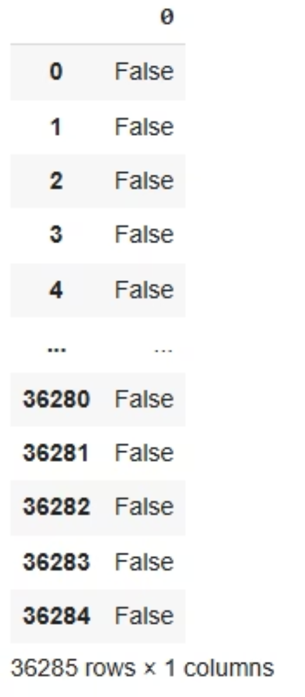
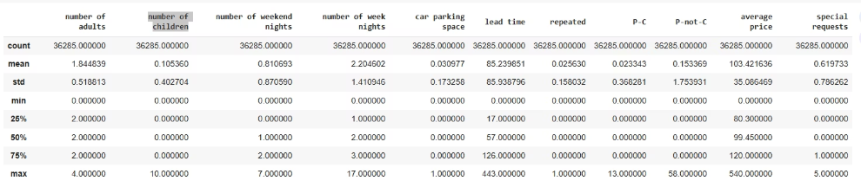
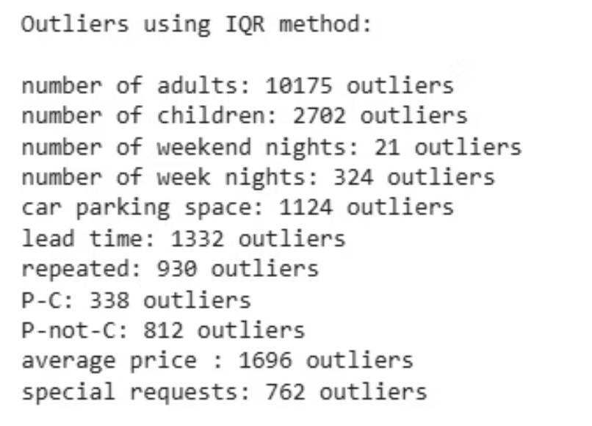
Check Data Quality and Statical Summary
Missing values
Duplication
Outliers

Slide 5


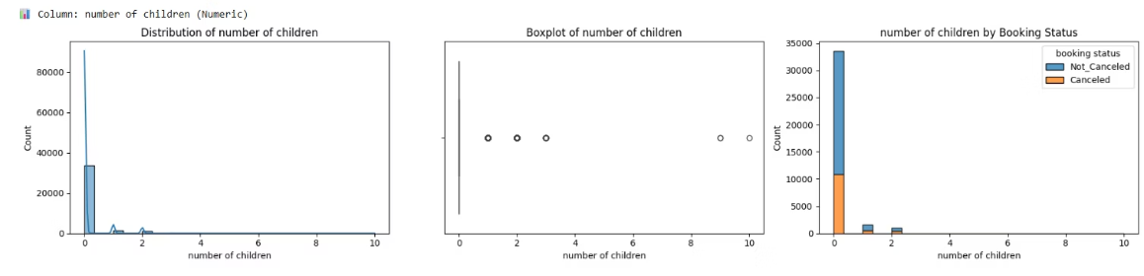
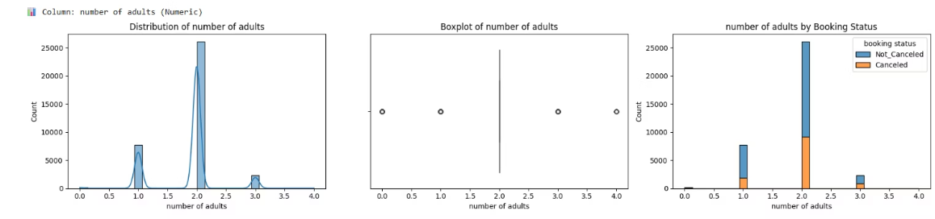
Guest Demographics: Adults & Children
Number of Adults
Number of Children
What is the most common number of adults per booking, Are there 0 adults bookings?
How many bookings have children vs none?

Slide 6
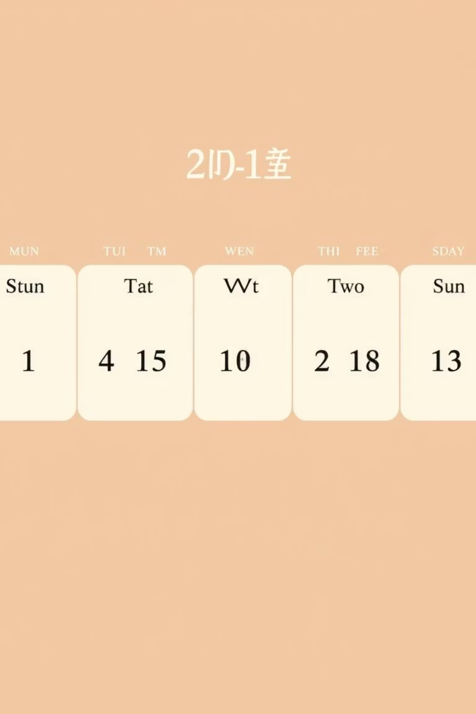
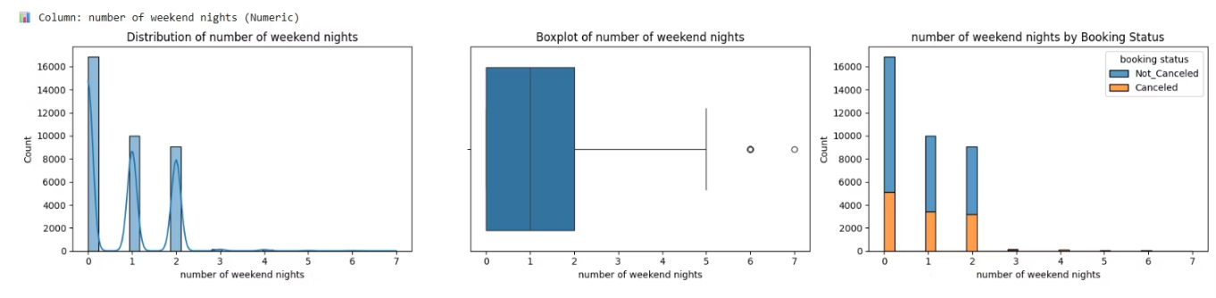
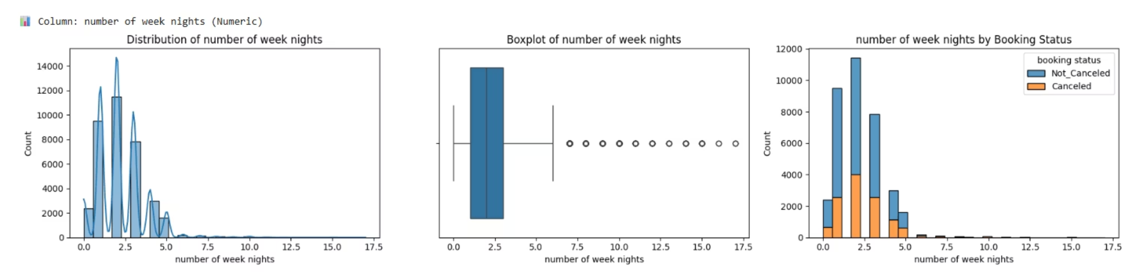
Stay Duration: Weekend & Week Nights
Weekend Nights
Do weekend stays get canceled more often?
Week Nights
What is the average weekday stay length?, and impact of length on booking status.

Slide 7

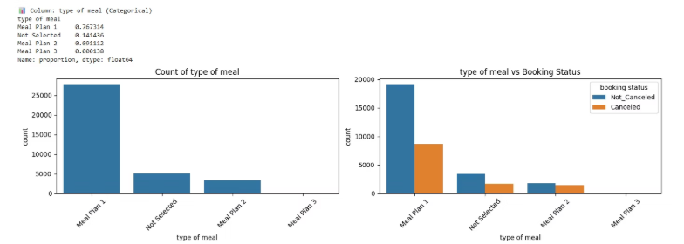
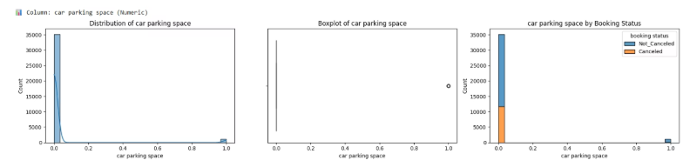
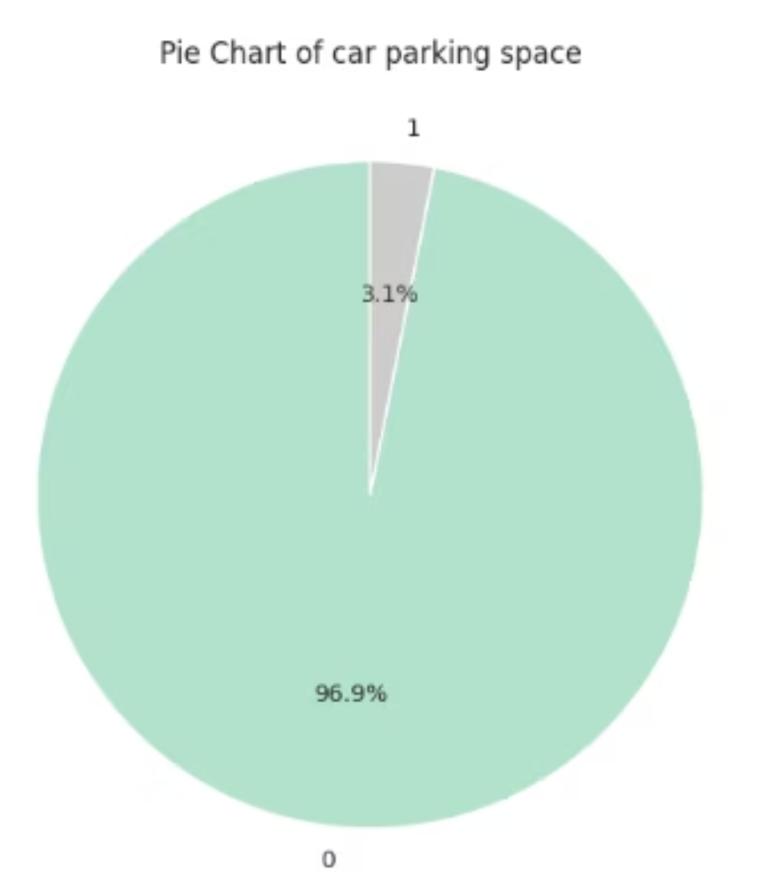
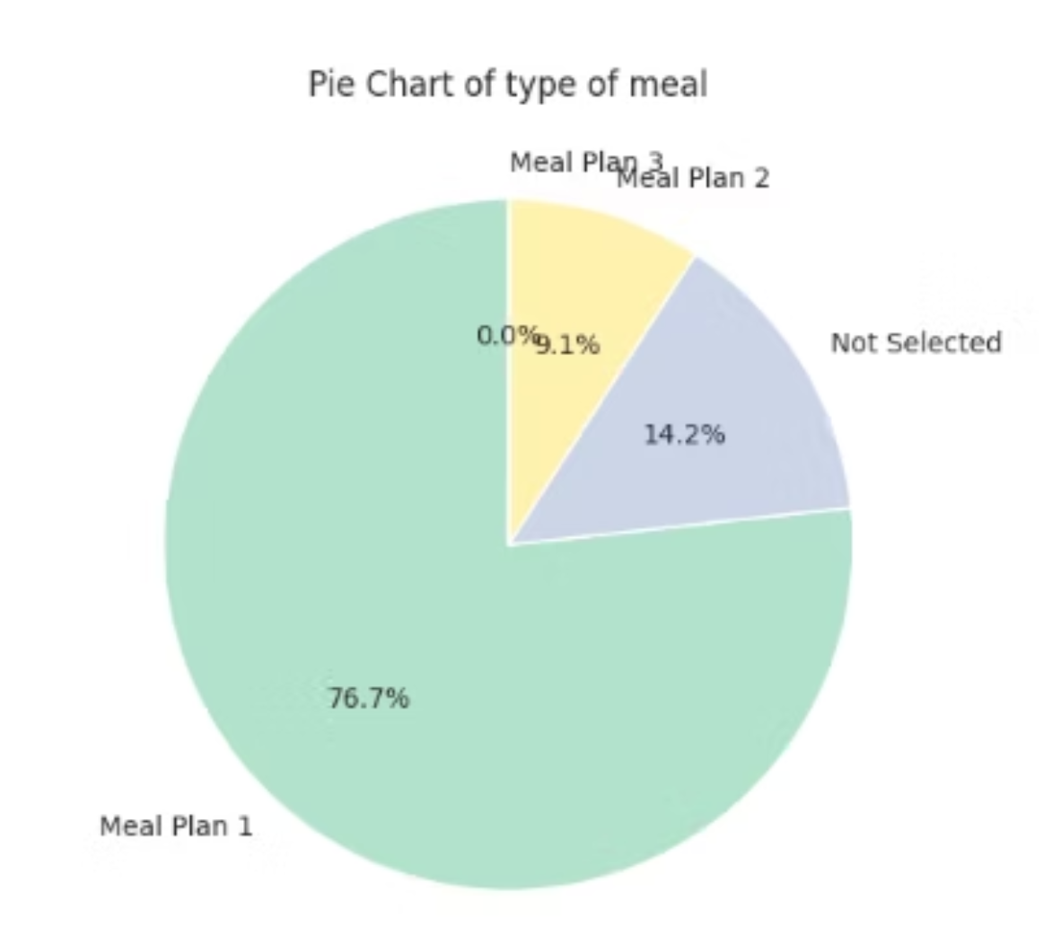
Booking Preferences: Meal & Parking
Type of Meal
Car Parking Space
Which meal plan is most popular? ,Do cancellations differ by meal type (e.g., “Not Selected” vs “Meal Plan 1”)?
What percentage of guests request parking? , Does having a car parking space affect cancellation?

Slide 8
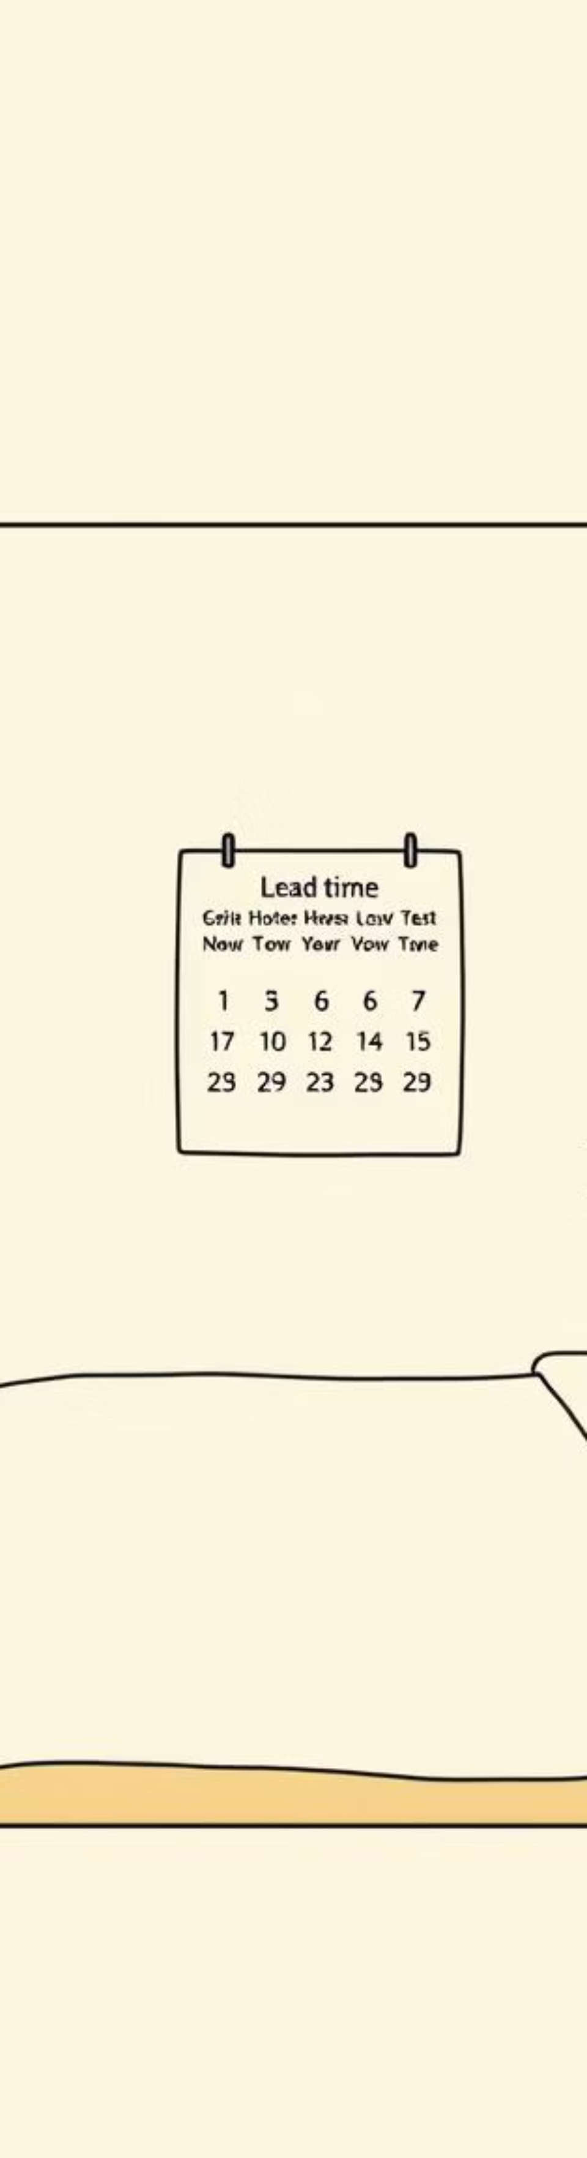
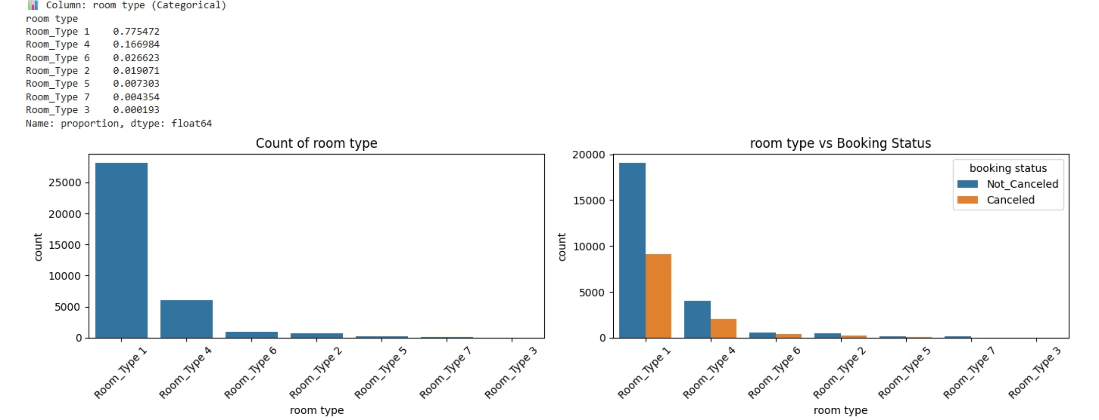
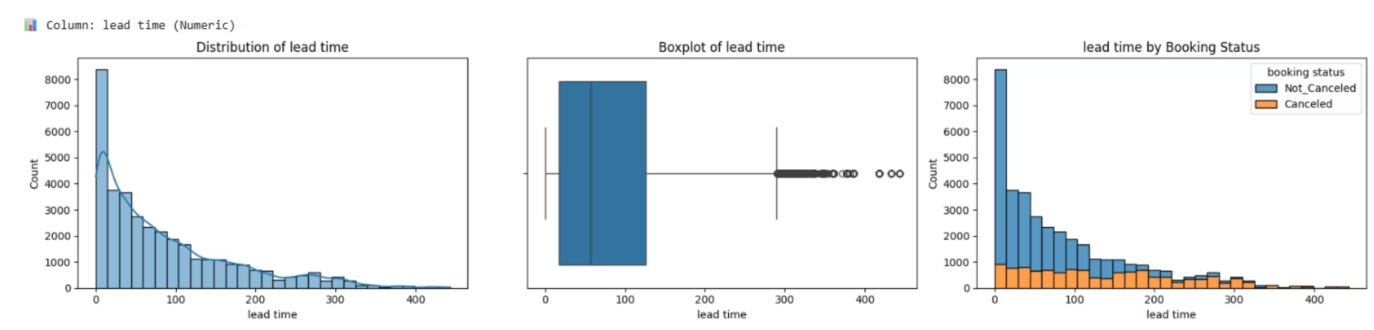
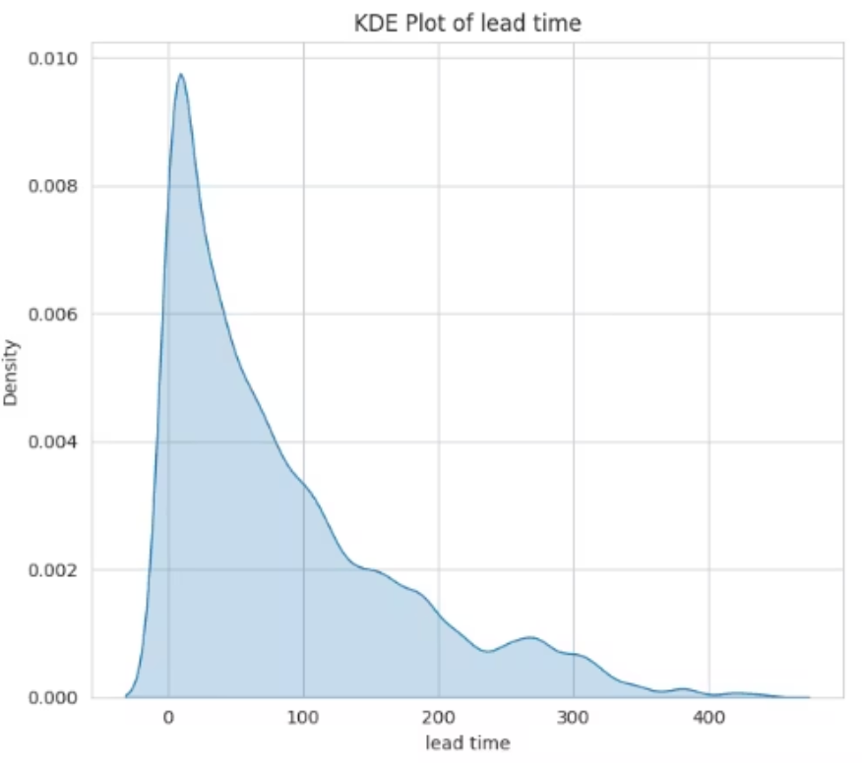
Room Type & Lead Time
1
Room Type
Which room type is booked the most? ,Do cancellations depend on room type?
2
Lead Time
What’s the distribution (last-minute vs long-term bookings)?, Do long lead times have higher cancellation rates?

Slide 9
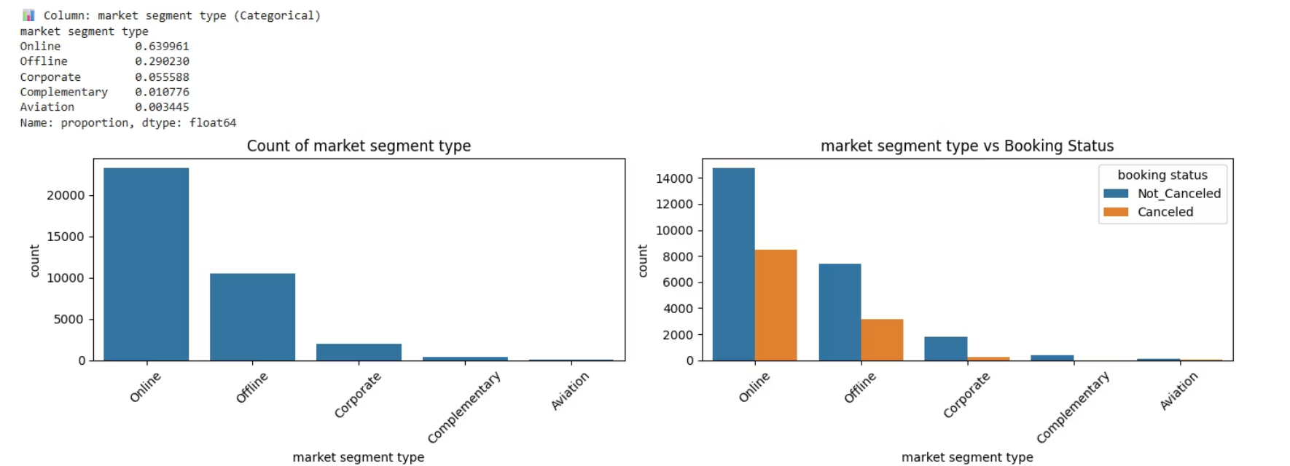
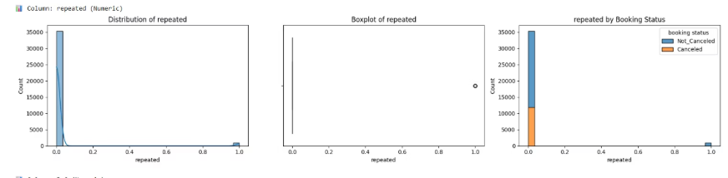
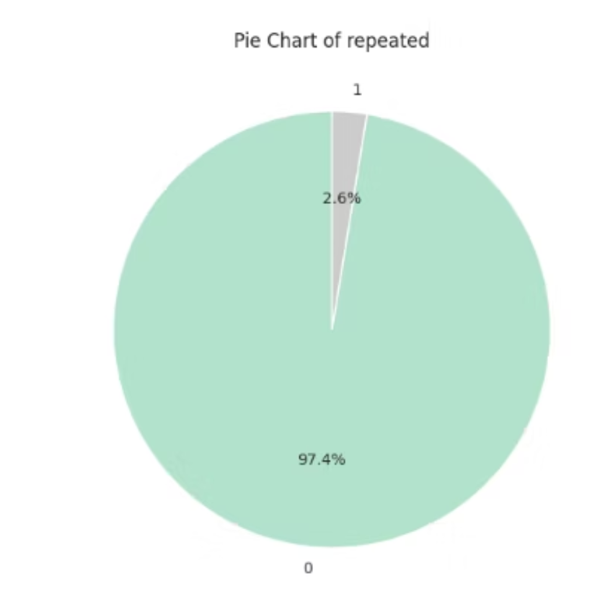
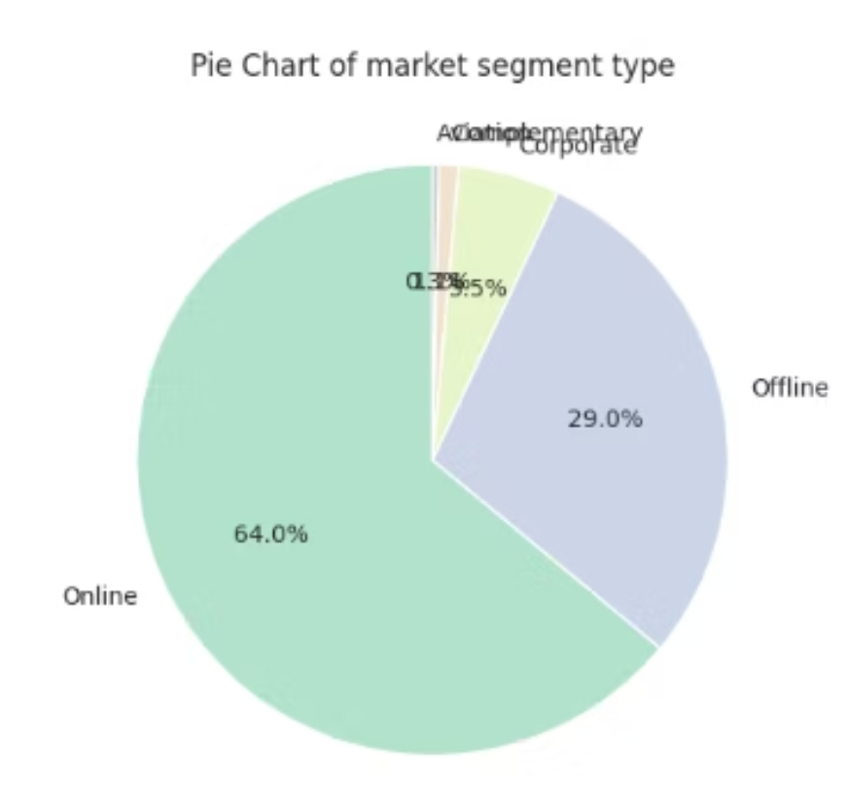
Guest Behavior & History
Market Segment Type
Repeat Guests
Do cancellations differ between market segments bookings?
What percentage of guests are repeat customers? , Are repeat guests less likely to cancel?

Slide 10

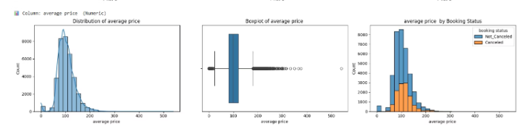
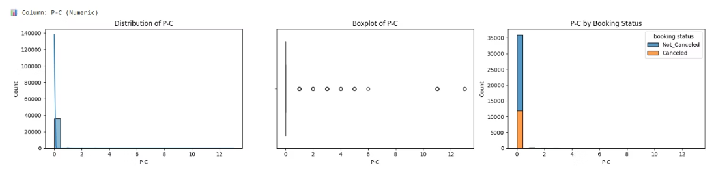
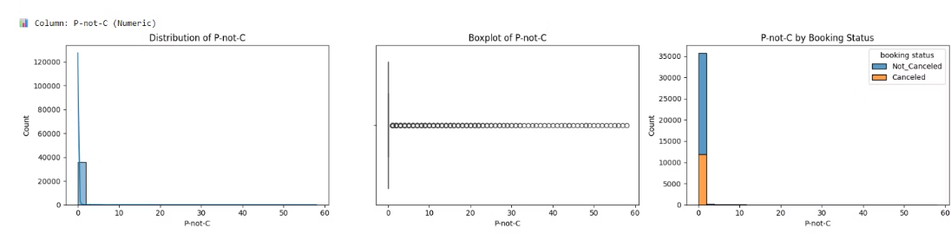
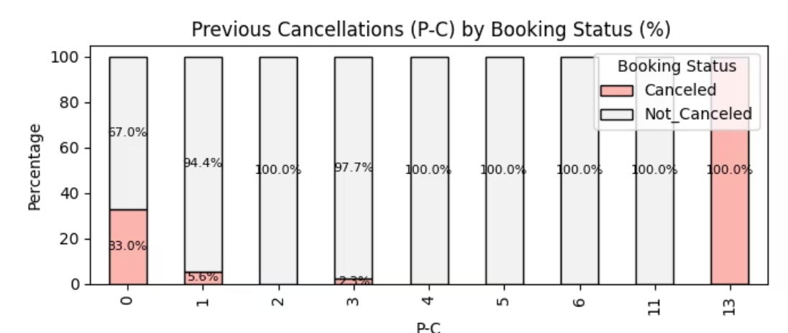
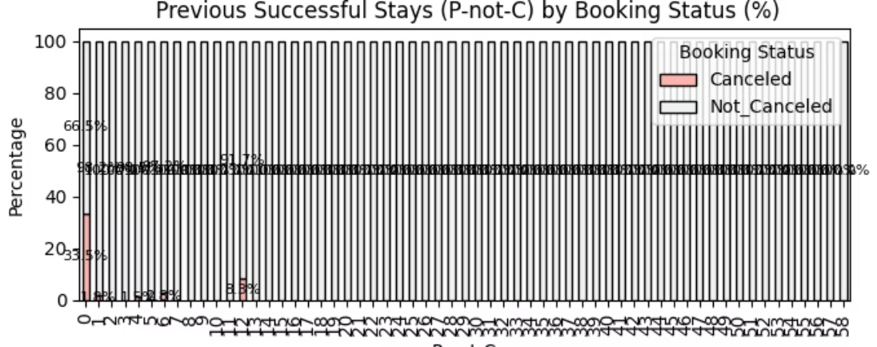
Cancellation History & Pricing
Previously Canceled (P-C)
Previously Not Canceled (P-not-C)
Average Price
What percentage of customers with at least one previous cancellation canceled their current booking?
What percentage of confirmed bookings come from customers who had multiple successful stays in the past?
Do cancellations increase for higher prices?

Slide 11
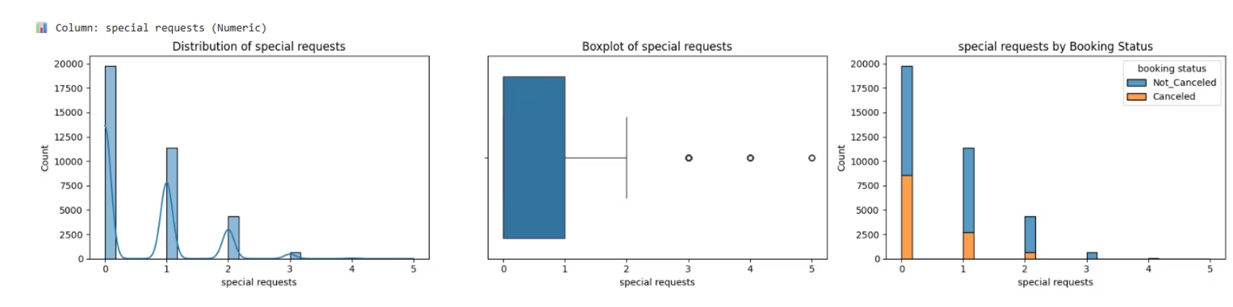
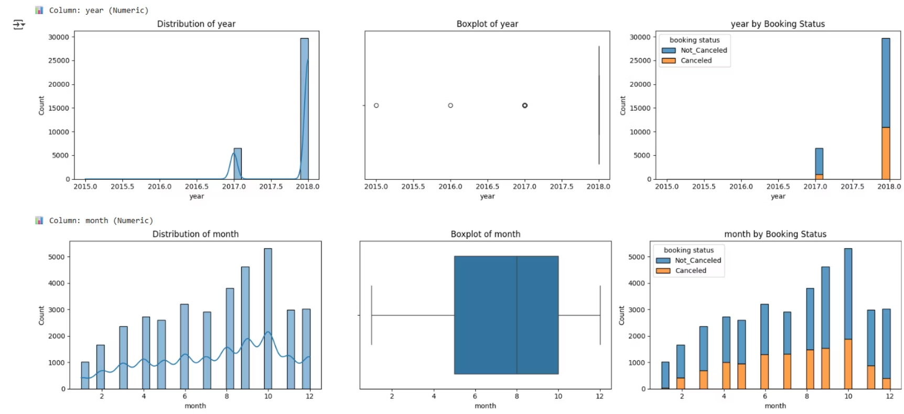
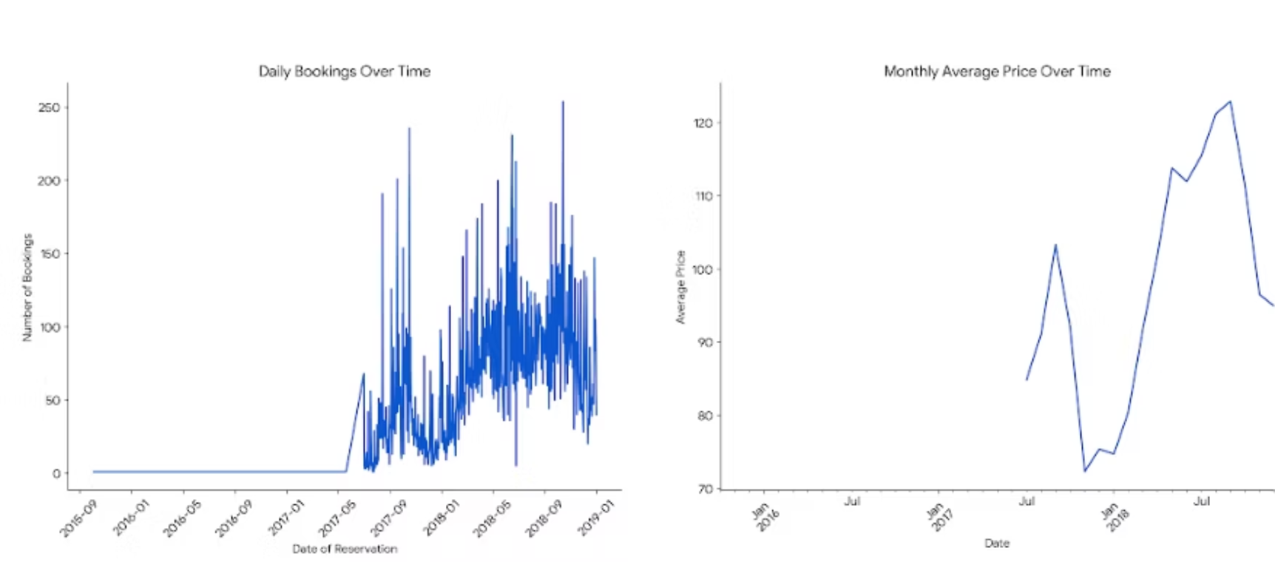
Special Request and Data of Reservation
Special Request
Data of Reservation
What is the common number of special requests per booking, and do bookings with more special requests have a lower cancellation rate?
Are there seasonal trends in bookings and cancellations? Which months or years show the highest volume of activity?

Slide 12
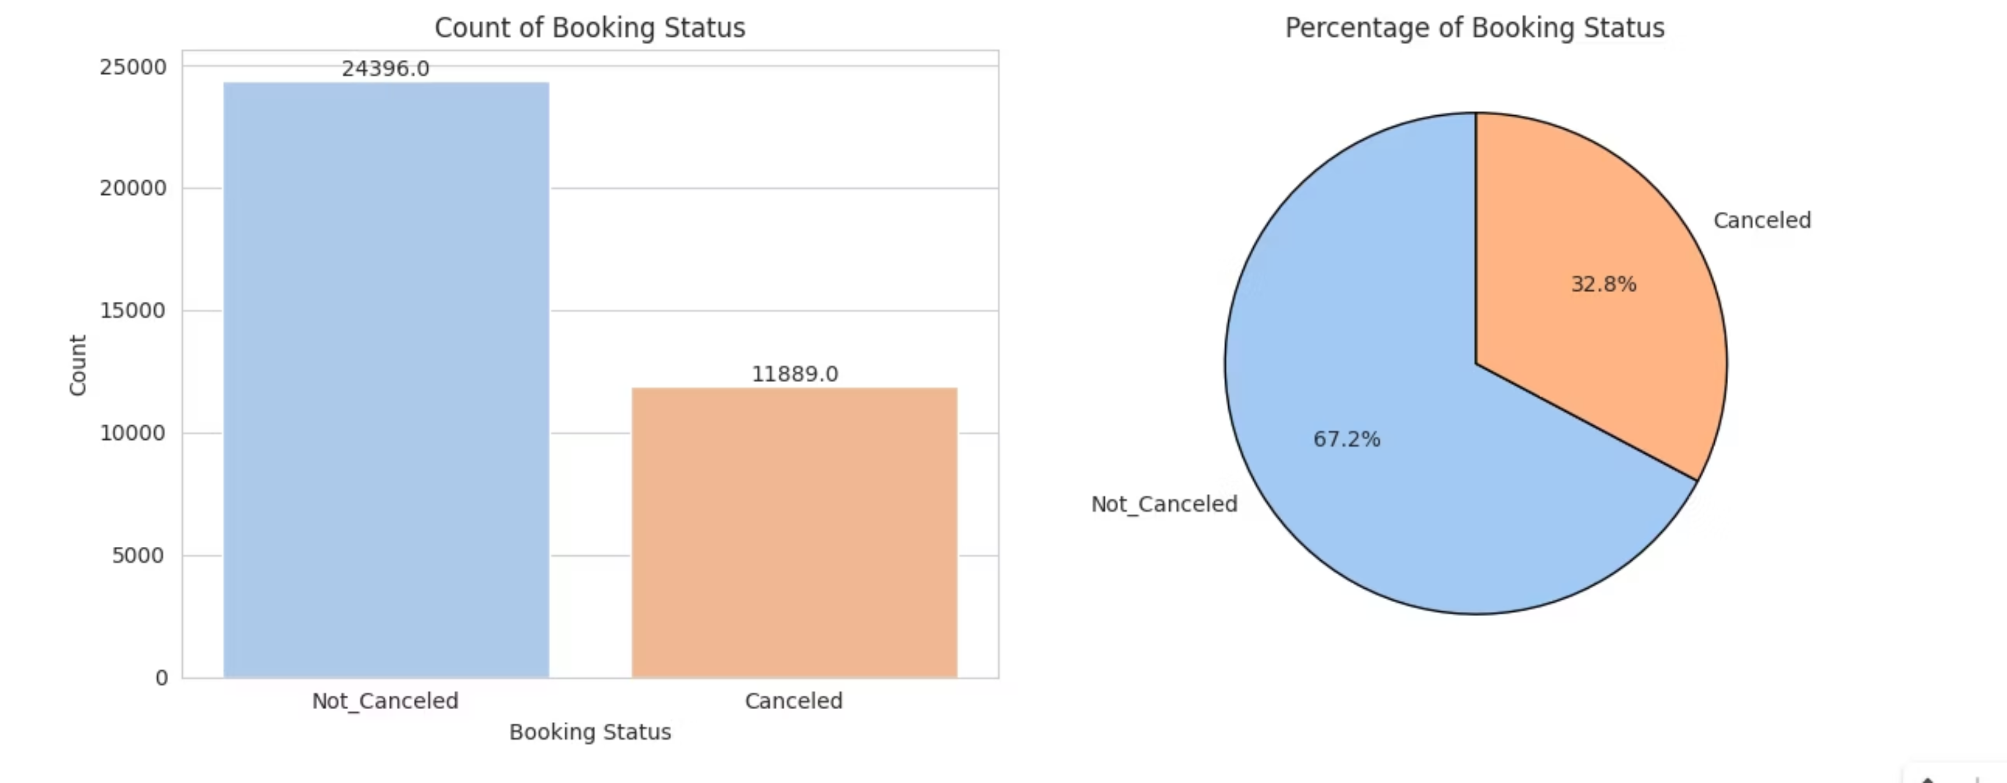
Booking Status
What percentage of bookings are Canceled vs Not_Canceled?

Slide 13

Summary & Next Steps
Key Insights
Future Work
This Exploratory Data Analysis (EDA) has provided a foundational understanding of critical factors influencing hotel booking cancellations. Our analysis highlights lead time, market segment type, average price, special requests and , booking status as key areas for further investigation.
Feature Engineering: Create new features (e.g., total nights, family size) for richer analysis.
Predictive Modeling: Develop a machine learning model to predict booking cancellations effectively.

Slide 14

Thank you

